Slide 1
Our Point of View on Social Learning
July 2016

Slide 2
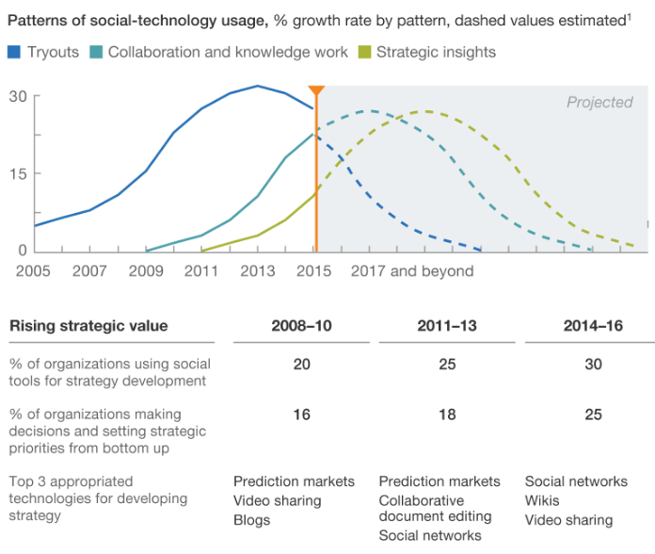
The evolution of Social Technologies, 3 stages of enterprise usage – McKinsey, June 2016
Tryouts
Marketers used Facebook or YouTube to acquire new customers or for interactions with existing customers, for example, to build relationships with social influencers.
Collaboration and knowledge work
Companies adopted social technologies such as Chatter, Connections, and Yammer to foster more collaboration, gather insights, or manage knowledge systematically.
Strategic Insights
Technology usage has matured at many companies that have forged internal and external networks, encouraging a range of stakeholders to participate in strategy development.

Slide 3
Definitions of Social Learning – Social Learning, Informal Learning and Peer-to-peer Learning
Social Learning | Informal Learning | Peer-to-peer Learning
 |  | Peer Tutoring | Peer Assessment | Study Groups
Learning happening with others, in the form of coaching and mentoring, leveraging networks of contacts, collaborative exploration and actions. | Informal learning is the unofficial, unscheduled, impromptu way most of us learn to do our jobs. | Peer Tutoring is where one student leads another through a concept, in which the first student is an ‘expert’ and the second is a novice. Typically, a higher performing learner is paired with a learner to provide guidance on critical concepts. | The most widely applicable approach for all MOOCs to date is the use of peer assessment to provide the necessary feedback by randomly selected peer raters. It’s effective when the learners are at a similar skill level and self-directed. | A self-organized group of people who meet to study a particular subject and then report their findings or recommendations.

Slide 4
Social Learning is a broad term, we have defined a working term what Social Learning means in Capgemini
At Capgemini we think Social Learning is learning happening with others, in the form of coaching and mentoring, leveraging networks of contacts, collaborative exploration and actions.
Social learning is not just the use of Yammer, although it makes use of it. Social learning is augmented with digital tools that bridge distance and time, enabling people to easily interact within and across geographies, projects, curiosity, skill, or need.
Examples –
When we meet a colleague in office, ask a question and conversation starts about a new topic. When we post the same question on Yammer or LinkedIn anticipating someone will respond.
When we share a video from YouTube or a blog post on What’s App and the conversation starts around the topic

Slide 5


We have piloted Social Learning products and Community Manager role and have learnt a few things along the way
What is important to succeed?
Senior management must walk the talk; if they don’t have time to engage on the collaboration platform, the rest of the organization may not find time either
Collaboration and cooperation must be rewarded
Individuals need to feel empowered; open and honest sharing cannot be driven by fear. Open and honest sharing comes from employees feeling respected and appreciated.
What really worked in the pilots?
The role of Community Manager - a dedicated person to facilitate connections and conversations, promote ideas and keep the engagement alive
Digital Communication – this includes the use of announcement, running online campaigns with animated banners and still posters, supported by weekly e-mails.
Micro Learning and User Experience – Short byte size videos, quiz and curated content on hot topics worked really well, with all content available on multiple devices
Architects Connect
A 3-month pilot on Slack
Digital Age Learning FVLJ
A 3-week pilot on Yammer

Slide 6
Social Learning Spectrum
Communities of Practice
(E.g., Architects Connect)
Cohort learning with others on a F2F course
Peer Review in MOOCs
YamJam
Backchannel in F2F
FVLJ
Peer Tutoring
Formal Social
Informal Social
Structured
Unstructured

Slide 7
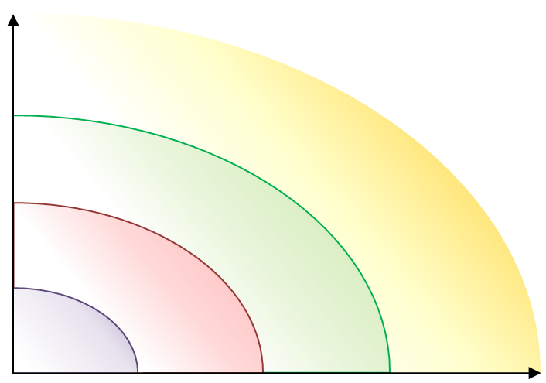
New tools, channels and methods at Capgemini Group Learning
Value
Personal
Do-It-Yourself (DIY)
Mobile and Tablets
Enable
Blog Writing (LinkedIn)
Social
Guided Social Collaboration (FVLJ)
Google, YouTube
Building Communities
Backchannel in F2F
Content Curation Tools
Provide
Resources
Micro Learning
Enterprise Social Networks (Yammer)
Networks
Portals
Video
Video Portal
Short Quiz
Courses
MOOCs
Analytics
MOOCs
Social Media (Twitter)
eLearning on MyL
Infographic
Learning
Campaigns
Podcast
Autonomy
Scheduled
On Demand
Continuous
Source: C4LPT

